Slide 1
This site can’t be reached

Slide 2
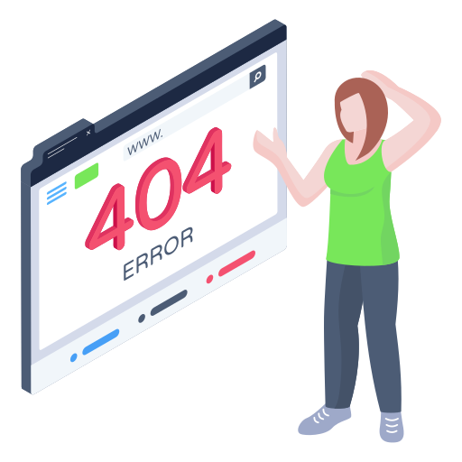
The requested URL was not found on this server

Slide 3
503 Service Temporarily Unavailable
The server is temporarily unable to service your request. Please try again later

Slide 4
Error 502
Bad gateway
Browser
Working
CloudProtection
Working
Host
Error

Slide 5
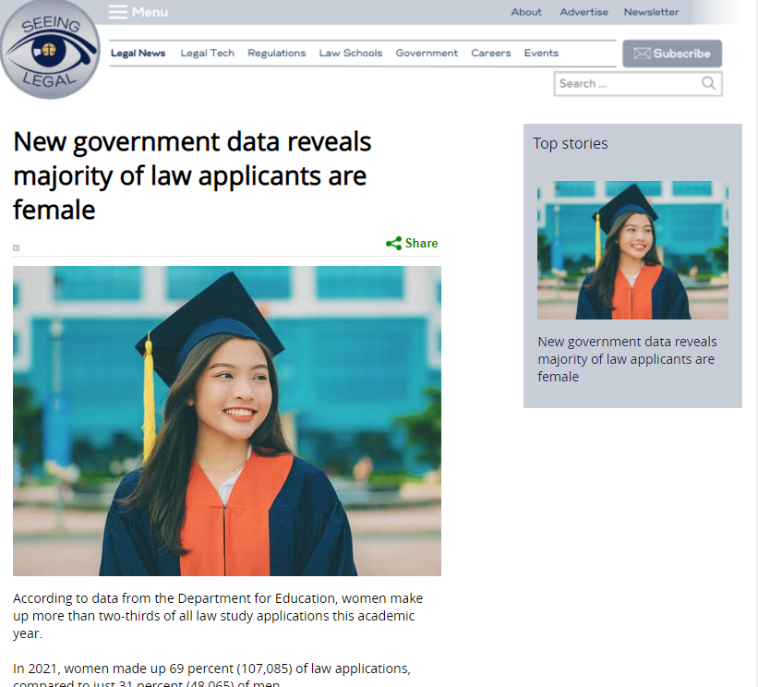
Error

